Slide 1

Movie recommendation engine
--Nikhil Kumar

Slide 2
The Architecture
Front-End
Back-End
PYTHON’S
FLASK
HTML/CSS
User
Get similar movies.
Similar movies using Cosine Similarity
Java Script
(jQuery)
Top 10
Recommendations
TMBD API Calls
TMDB

Slide 3
The ALGORITHM
Cosine Similarity
In Data Mining, similarity measure refers to distance with dimensions representing features of the data object, in a dataset. If this distance is less, there will be a high degree of similarity, but when the distance is large, there will be a low degree of similarity.
Among many methods , Cosine Similarity is a very apt method.

Slide 4
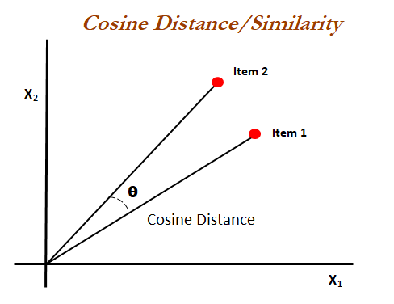
The ALGORITHM
Cosine Similarity
Cosine similarity is a metric used to measure how similar the documents are irrespective of their size. Mathematically, it measures the cosine of the angle between two vectors projected in a multi-dimensional space.
The cosine similarity is advantageous because even if the two similar documents are far apart by the Euclidean distance (due to the size of the document), chances are they may still be oriented closer together. The smaller the angle, higher the cosine similarity.

Slide 5
The ALGORITHM
BTS→
After merging the different datasets , to find most similar movies , all the relevant attributes are sort merged into tags and then using COUNTVECTORIZER function , they are converted into vectors.
So each movie’s data is represent as vectors.
All the tags are merged and then top words are been selected and then for similarity , they are mapped or checked with individual vectors.
On the basis of it different vectors are compared using the Angle between them.

Slide 6
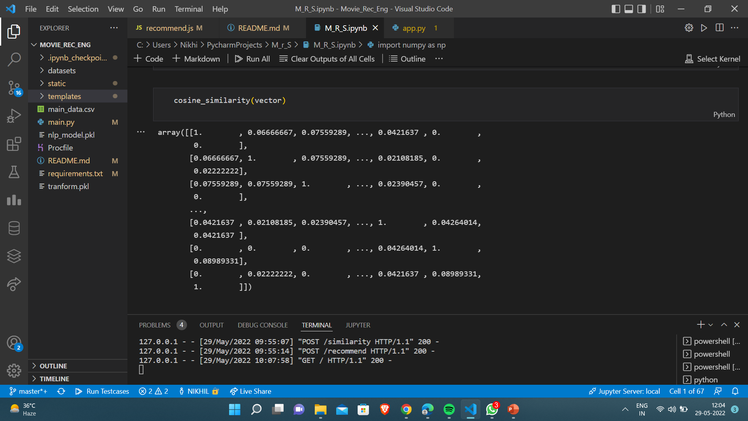
BTS→
Individual Vectors

Slide 7
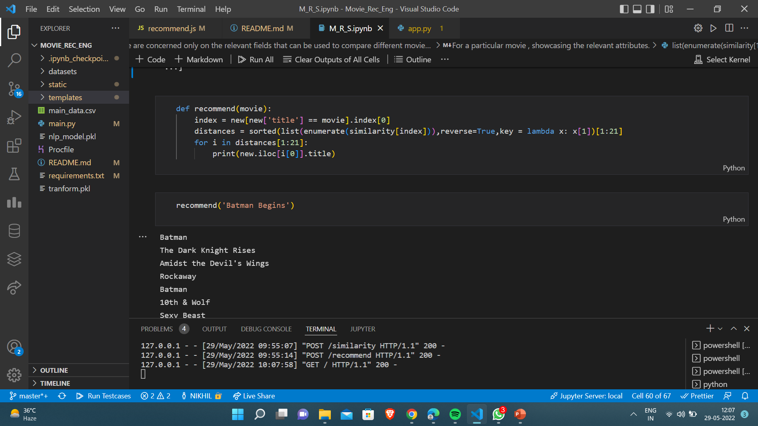
The function

Slide 8
Thank you

